Slide 1
My First App!
What I am trying to accomplish, and where I’m totally failing

Slide 2

Mock-up of App: Front page
1
1
3
# of utilities modeled in the state
3
2
I was thinking about using D3 here as the visualization and charting tool; there’s a cool map here that I want to copy - http://bl.ocks.org/michellechandra/0b2ce4923dc9b5809922
1
Alaska
Hawaii

Slide 3
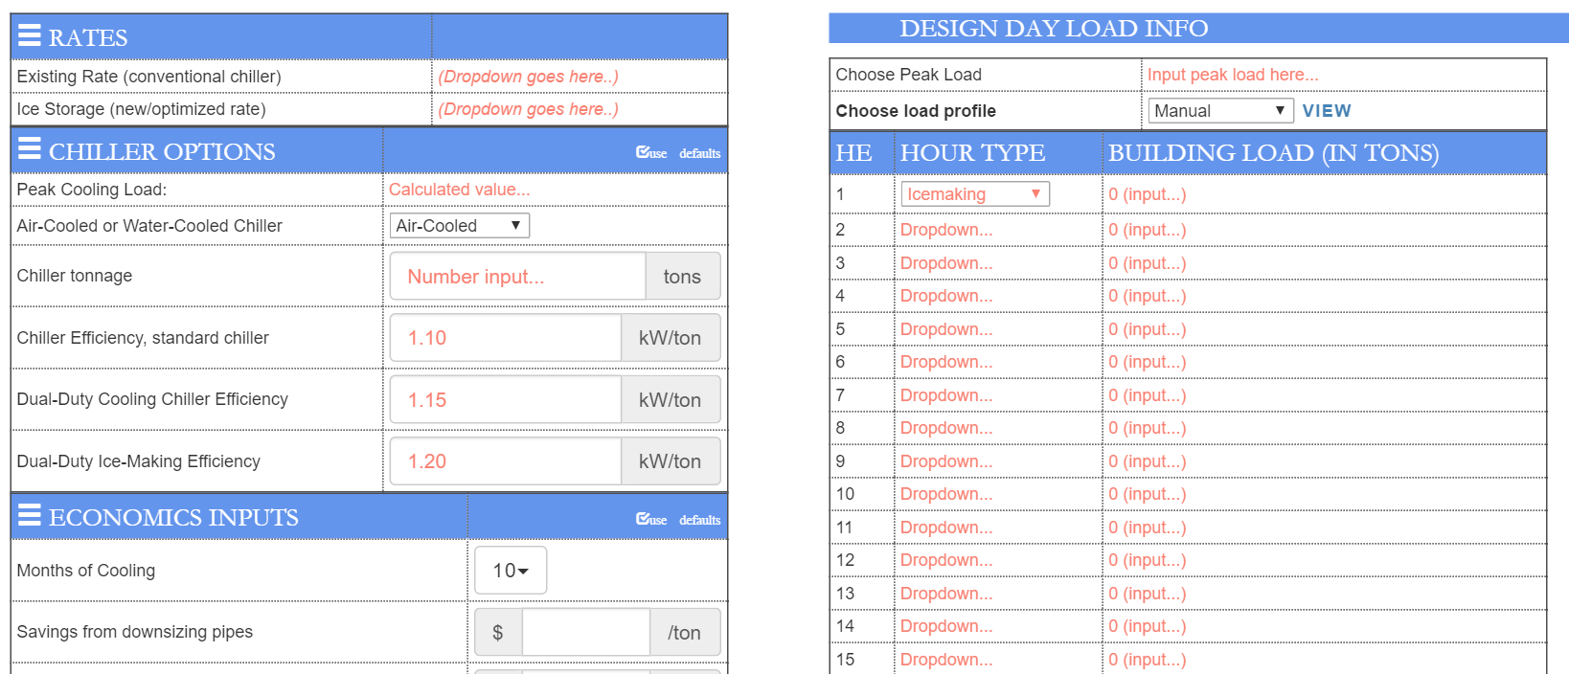
Mock-up of App: Inputs Page
I’ve designed this in React/ Meteor. It’s on Github.
The things I am missing are:
How to get the data from the “Design Day Load Info” to pass into MongoDB. No idea how to do that.
Creating a “use default” button for each of the left-hand sections.
Making accordion-style menus on the left-hand sections.
Getting the links to work – I know how to do this in Express, but haven’t figured out how to do this in Meteor yet. The whole POST and GET thing.

Slide 4
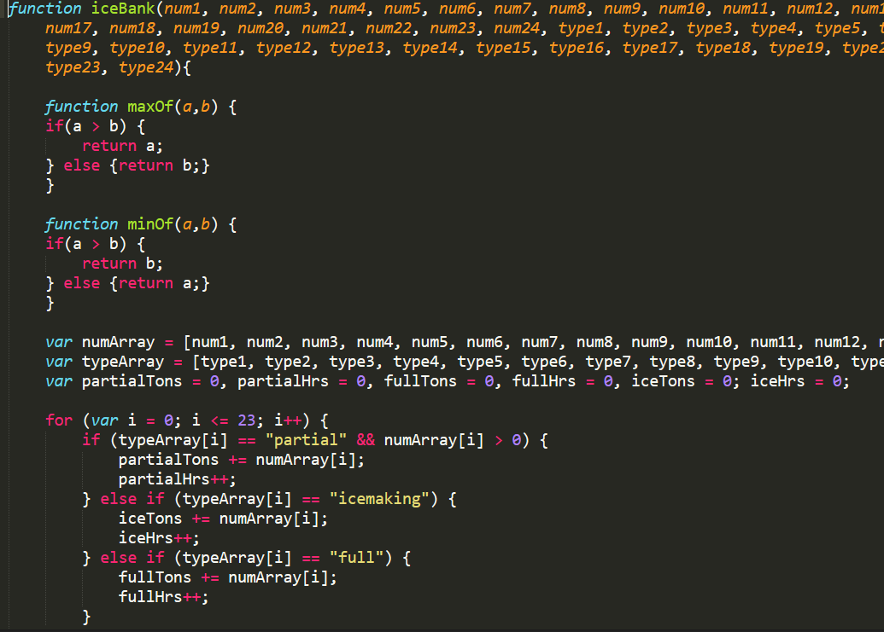
Logic
I put together a function in plain JS that does a decent job approximating the “optimization” that I am trying to accomplish. The file is on Github; it’s called icemaking_function_draft.js.
The JS file creates an output called “var stackedBar” – it is an array, with 24 arrays inside of it.
Each of the 24 sub-arrays has the HourName (for example, “HE1”, “HE2” etc.), and the amount of icemaking, chiller use, and ice dispatch hours.
I would like to turn this into a cool bar chart.

Slide 5
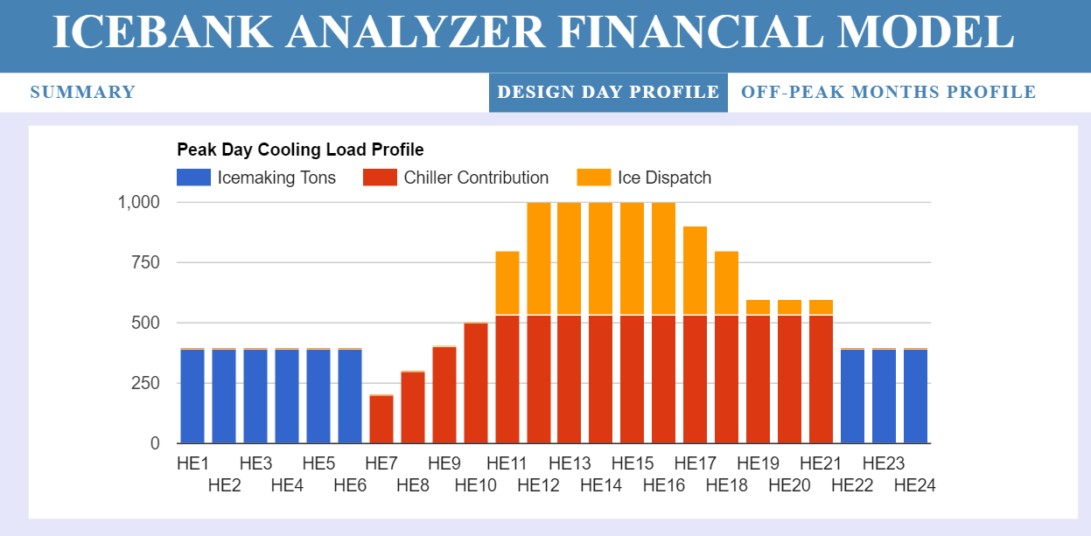
Graphical Output – the “cool” bar chart
This is that “cool” bar chart I was talking about; it is definitely not so cool.
I made this with Google Charts, which isn’t so great. I am trying to learn a data visualization tool called D3; I haven’t figured that out yet. I’m working on it right now.
This is the kind of responsive stacked bar chart that I’d like to build - http://c3js.org/samples/chart_bar_stacked.html
C3 is an add-on to D3; I don’t necessarily have to use it. I don’t have to use D3 either – I just want to learn to make charts!

Slide 6
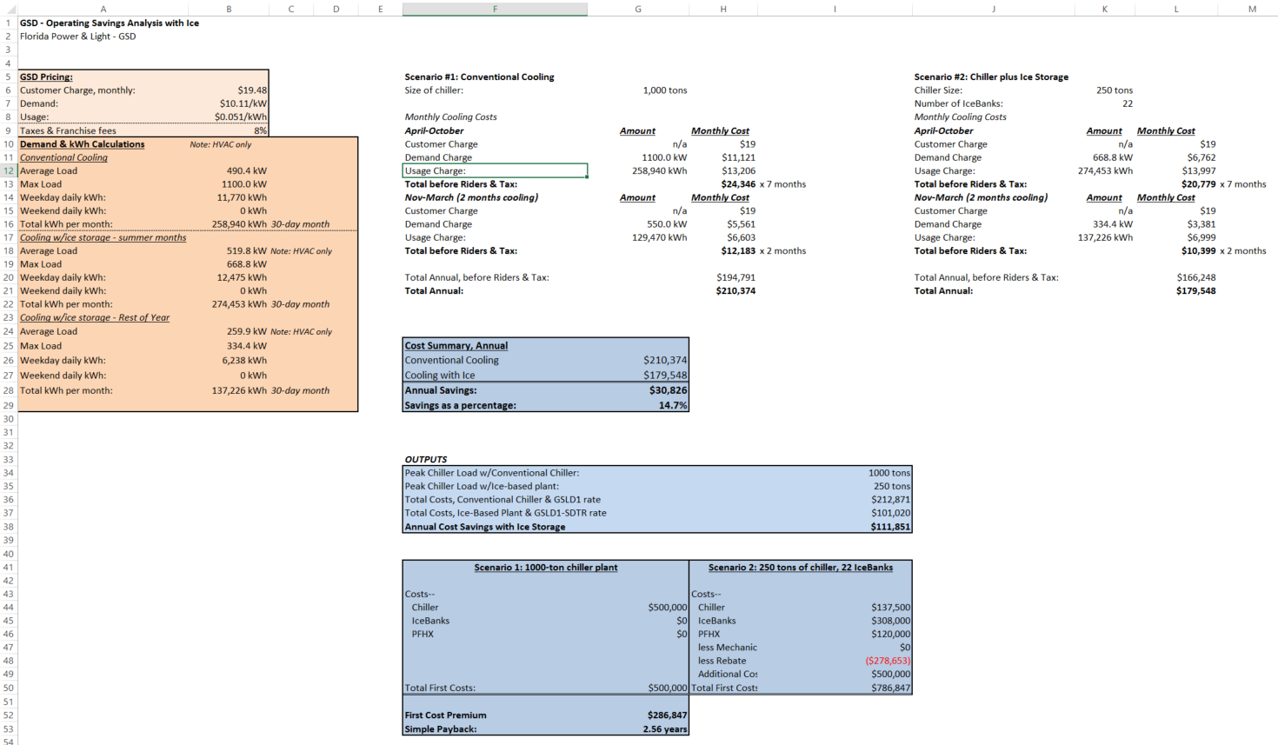
Economic Output – no code for that yet
The Economic Analysis is the last part of the project – I haven’t started this yet. Basically, the idea is to take what I typically do in Microsoft Excel and turn it into a fancier web page. On the left I show the Rates information in peach color; in the middle I have month-by-month breakdowns of the costs of each option, and at the bottom, in blue, I have the financial analysis.
In Meteor, I want to build components for each of the three things:
The Rates panel
The monthly costs section
The Economic outputs
Maybe there can be some way where the Rates panel can be shown/disappeared?
Also, I need to figure out how to take these values and turn them into a template – because I want to do over 100 versions of this.
Finally, there’s the Mongo piece of the puzzle – I don’t understand how to do that yet.

